Slide 1

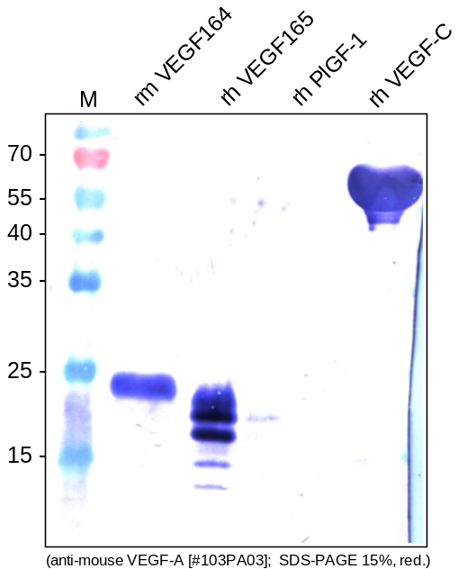
ReliaTech GmbH
Rabbit anti-mouse VEGF-A
(Cat #103-PA03)
Figure 1. Western analysis of recombinant mouse VEGF164 [Cat# M30-001], human VEGF165 [Cat# 300-036], human PlGF-1 [Cat# 300-015] and rat VEGF-C [Cat# R20-015] using a polyclonal rabbit anti-mouse VEGF-A antibody [Cat# 103-PA03]. There is a strong cross reactivity with human VEGF₁₆₅ but not with human PlGF-1 and human VEGF-C.
http://www.reliatech.de / orders@reliatech.de

